Slide 1

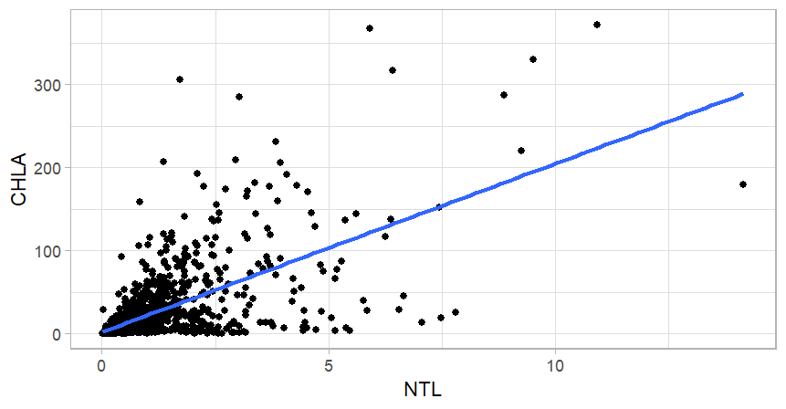
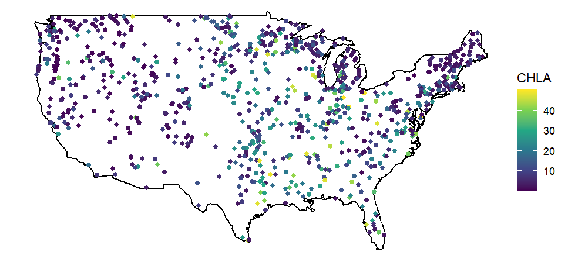
Visualization of Large Data Sets for Developing Research Questions

Slide 2

Environmental Protection Agency
National Aquatic Resource Surveys
National Lakes Assessment 2017

Slide 3
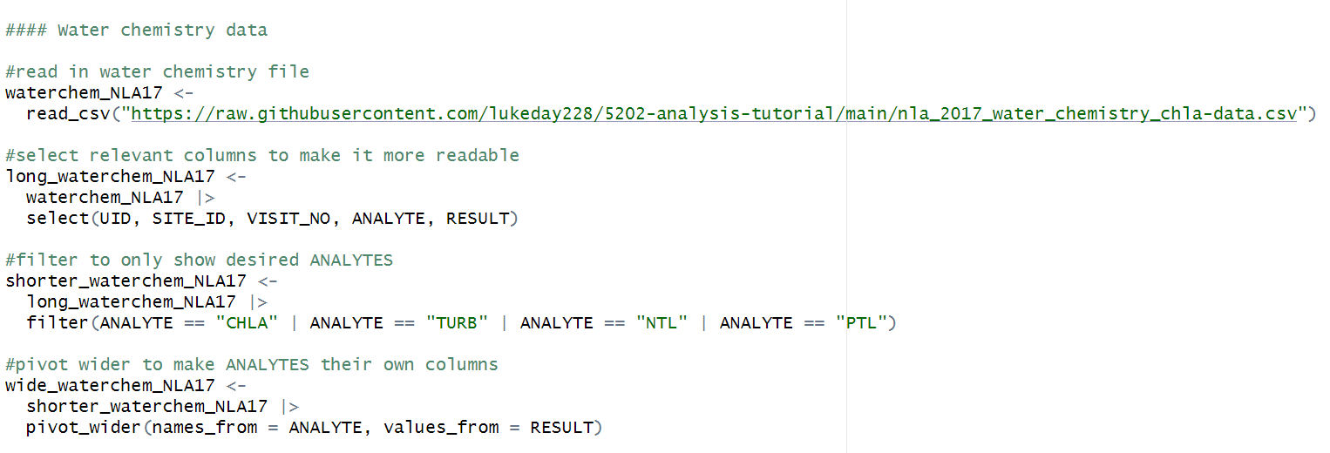
Organizing Data

Slide 4
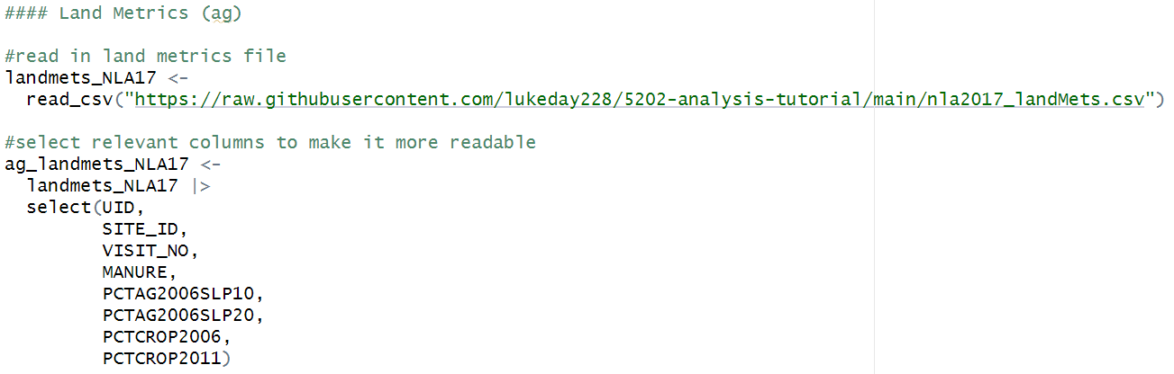
Organizing Data

Slide 5
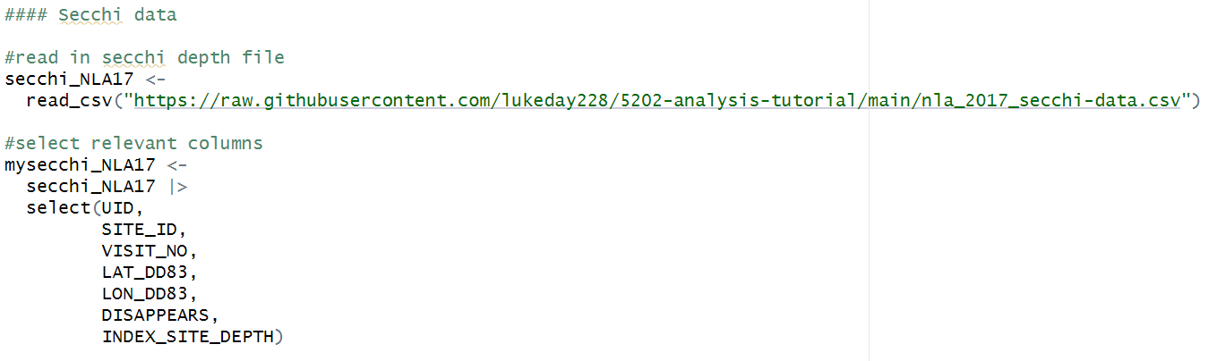
Organizing Data

Slide 6
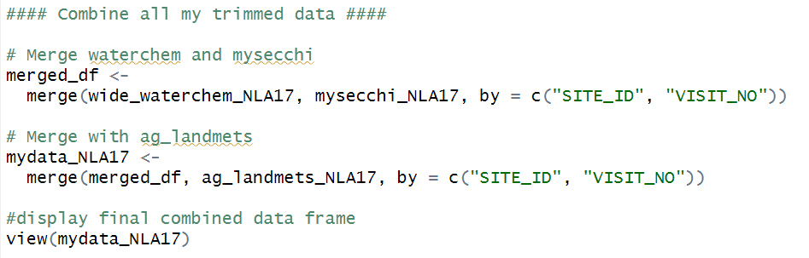
Combining Data

Slide 7
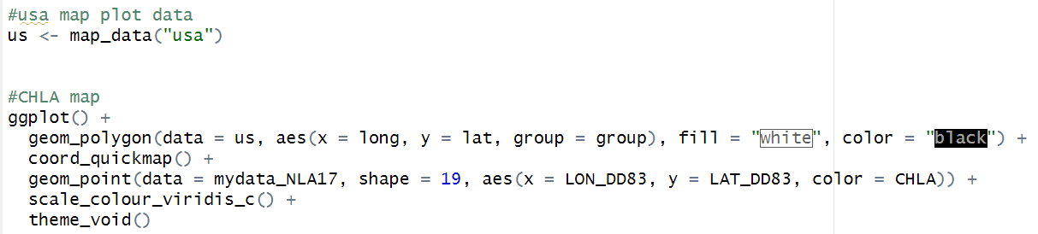
Finally… Visualization

Slide 8
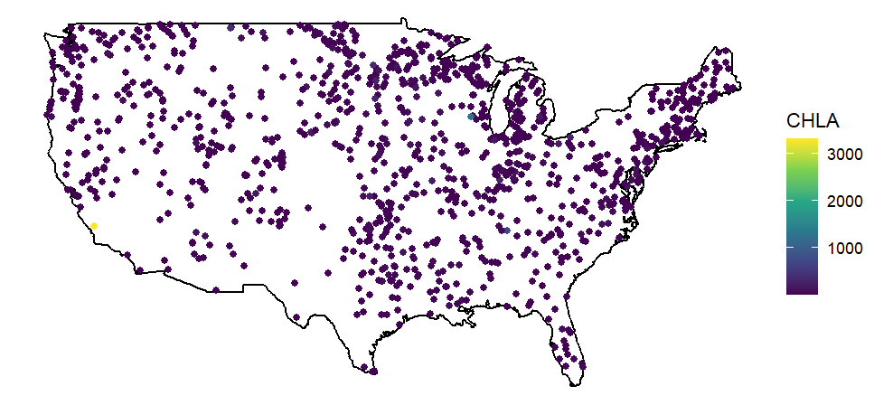
Chlorophyll-A Concentration (ug/L)

Slide 9
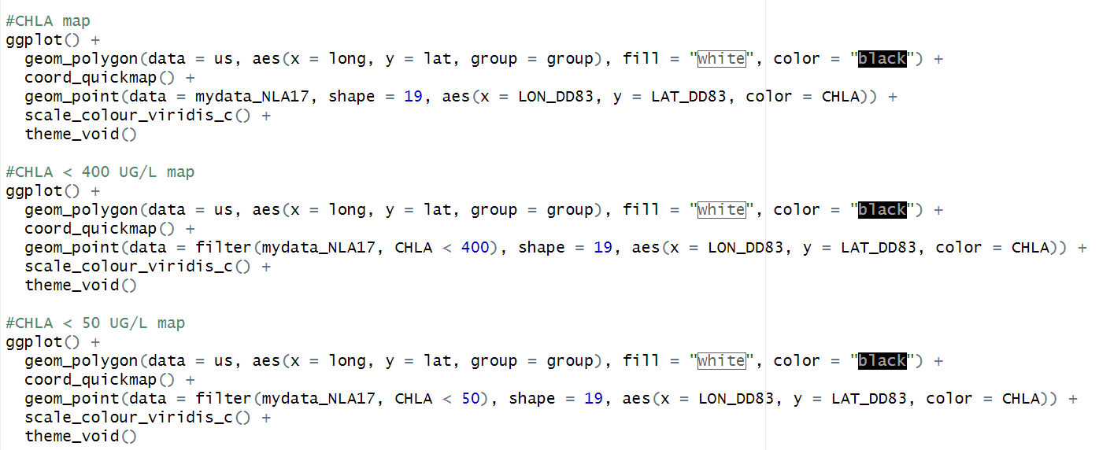
Dealing With Outliers… the lazy way

Slide 10
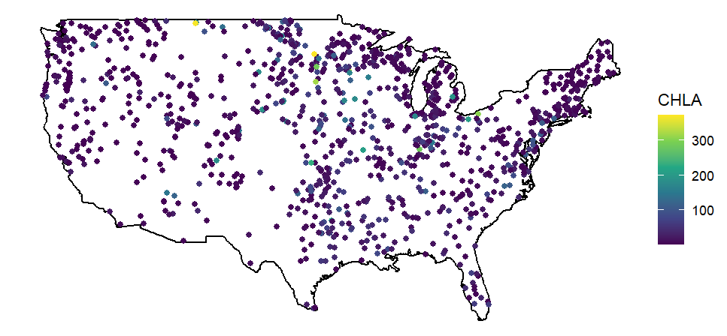
Chlorophyll-A Concentration < 400 ug/L

Slide 11
Chlorophyll-A Concentration < 50 ug/L

Slide 12
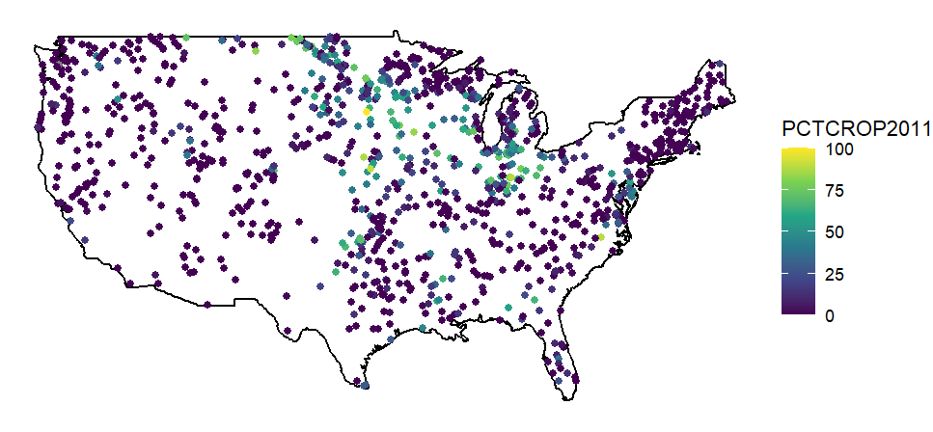
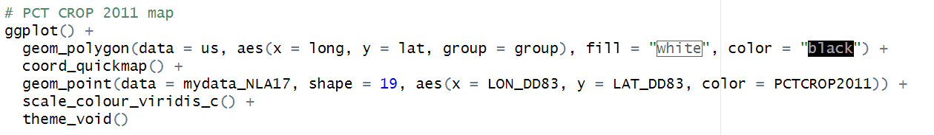
Percentage Crop Land in Watershed

Slide 13
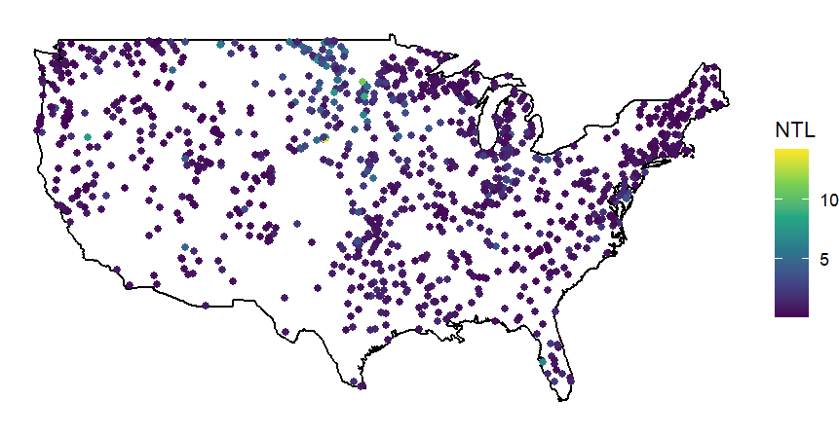
Total Nitrogen (mg/L)

Slide 14
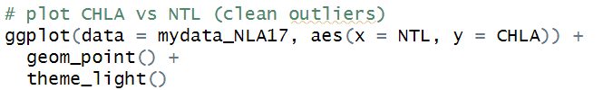
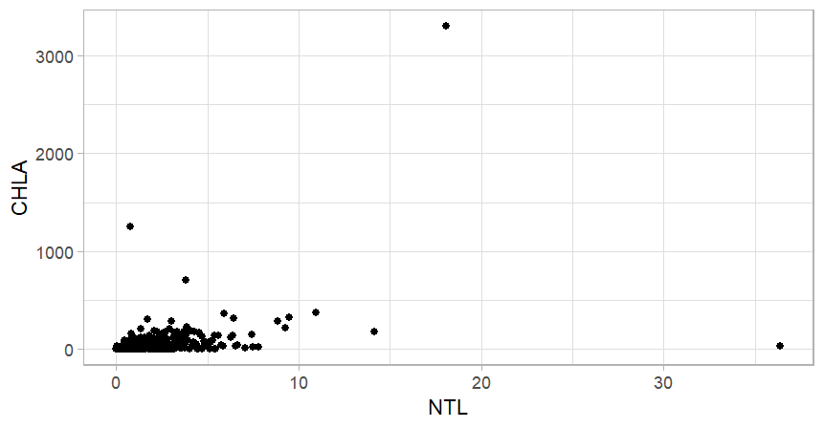
Total Nitrogen vs Chlorophyll-A

Slide 15
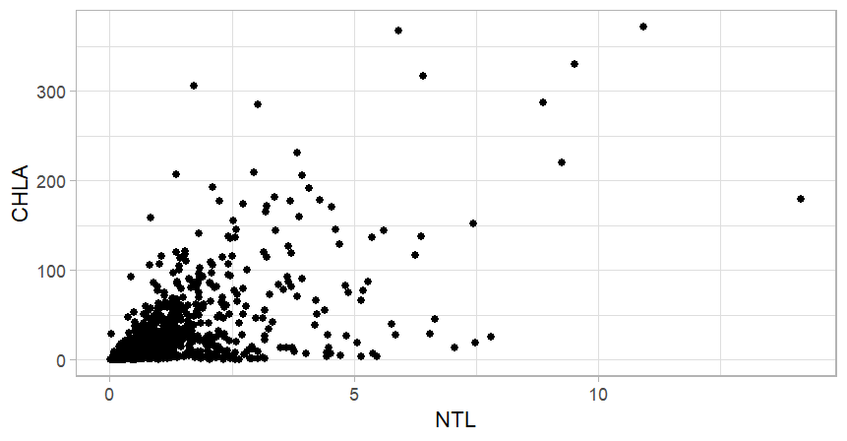

Slide 16
Correlation? Are there confounding factors?

Slide 17
Rapid Visualization of Large Data Sets

Slide 18
Questions?

